Slide 1

Using Image Forensic and Wavelet Transform for Detecting Deep Fake Images
Osama Rawy
University of Leeds
od20or@leeds.ac.uk

Slide 2
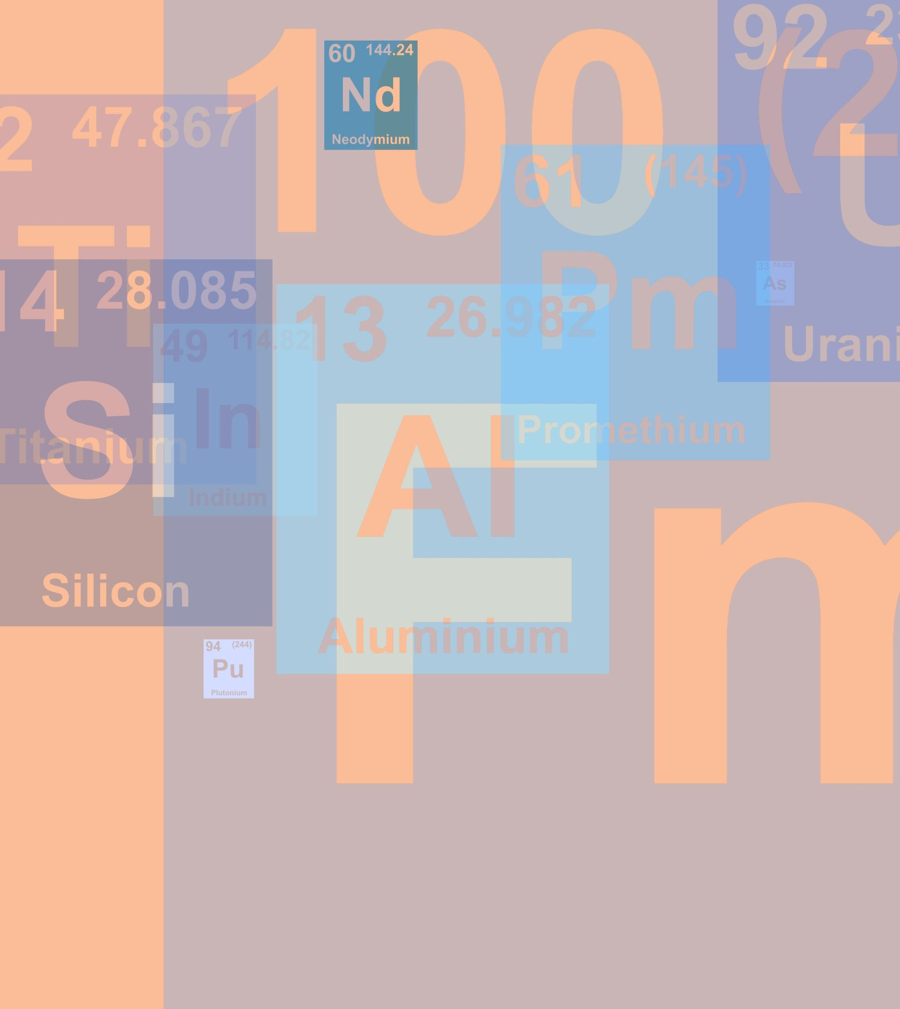
Introduction
AI was the hottest topic in the world of art and design during 2022 and 2023 due to the breakthrough of generative-based applications like Midjourney. Such applications can generate photos or videos with a high level of realism that a normal person can’t identify the truth. Although, this could advance media production, business, and education, however, the same tools could be easily used by criminals to falsify official documents or to intimidate innocent victims with fabricated bad images.
For this reason, it became essential to have a stronger detection mechanism that can identify true from false with high accuracy. In this project I will visit previous work in this domain especially focusing on DL-based approaches and at the end I will propose a new model that combines the strength points of two previous models, the first used Error Level Analysis and the second used Wavelet Transform. By this, I aim to provide a DF detection mechanism with a high level of immunity that can be easily generalized on new unseen images.

Slide 3
Relevant Work and References
In the following table I show a list of previous work in Deep Fake Detection plus other relevant references which I plan to base on in my paper.
No. | Author | Title | Technique | Performance | Cons
1 | Matern et al. | Exploiting visual artifacts to expose deepfakes and face manipulations. in 2019 IEEE Winter Applications of Computer Vision Workshops (WACVW). 83–92 (IEEE, 2019). | MLP | AUC = 85% | Study considers facial images with open eyes only.
2 | Agarwal et al. | Protecting world leaders against deep fakes. in CVPR Workshops. Vol. 1. 38 (2019). | Feature Extraction: Open Face 2 toolkit Classification: SVM | AUC = 93% | The system provides incorrect results when a person is not facing camera
3 | Ciftci et al. | Fakecatcher: Detection of Synthetic Portrait Videos Using Biological Signals (Google Patents, 2021). | Feature Extraction: Classification: CNN | Accuracy= 97% | The system is computationally complex due to a very large feature vector.
4 | Yang et al. | Exposing deep fakes using inconsistent head poses | Feature Extraction: Dlib Classification: SVM | ROC = 89% | The system is not robust to blurred and requires a preprocessing stage
5 | Rossle et al. | Faceforensics++: Learning to detect manipulated facial images. in Proceedings of the IEEE/CVF International Conference on Computer Vision. 1–11 (2019). | Feature Extraction: Co-Occurrence matrix Classification: SVM + CNN | Accuracy= 90.29% | the system provides poor results on compressed videos
6 | McCloskey et al. | Detecting GAN-generated imagery using saturation cues. in 2019 IEEE International Conference on Image Processing (ICIP). 4584–4588. (IEEE, 2019). | Feature Extraction: Classification: SVM |  | the system may struggle on non-preprocessed and blurry images.
7 | Wodajo et al. | Deepfake Video Detection Using Convolutional Vision Transformer (2021). | CVT Mechanism Feature Extraction: Attention + MLP Classification: |  | the system is computationally expensive due to deep architecture
8 | Guarnera et al. | Deepfake detection by analyzing convolutional traces. in Proceedings of the IEEE/CVF Conference on Computer Vision and Pattern Recognition Workshops. 666–667 (2020). | Feature Extraction: Expectation Maximization Classification: SVM, KNN, LDA |  | the system fails in recognizing compressed images
9 | Nguyen et al. | Multi-task learning for detecting and segmenting manipulated facial images and videos. in 2019 IEEE 10th International Conference on Biometrics Theory, Applications and Systems (BTAS). 1–8. (IEEE, 2019). | CNN Based | Accuracy= 83.7% | system is unable to generalize well on unseen cases
10 | Khalil et al. | Integrated Capsule-Based Model for Deepfake Image and Video Detection. Vol. 13(4). 93 (2021). | Feature Extraction: Local Binary Patterns Classification: CNN and Capsule Network
11 | Afchar et al. | A compact facial video forgery detection network. in 2018 IEEE International Workshop on Information Forensics and Security (WIFS). 1–7 (IEEE, 2018). | MesoInception-4 | TPR = 81.3% | The system requires preprocessing before feature extraction and classification. Hence, results in a low overall performance on low-quality videos.
12 | Wang et al. | A video is worth more than 1000 lies. Comparing 3DCNN approaches for detecting deepfakes. In 2020 15th IEEE International Conference on Automatic Face and Gesture Recognition (FG 2020). 515–519. (IEEE, 2020). | ResNet and ResNeXt
13 | Rimsha et al. | Deep fake detection and classification using error-level analysis and deep learning. Sci Rep 13, 7422 (2023). https://doi.org/10.1038/s41598-023-34629-3 | Feature Extraction: ELA + ResNet18 Classification: KNN | Accuracy= 89.5%
14 | Moritz et al. | Wavelet-Packets for Deepfake Image Analysis and Detection
15 | Ethan et al. | Divergences in color perception between deep neural networks and humans, Cognition,Volume 241,2023,105621,ISSN 0010-0277,

Slide 4
Proposed Novel Ideas to Work on
In my research I will focus on the following ideas:
Build on the wavelet applet transform proposed by Moritz et al. and complement its strength with Forensic detection algorithm like “Error Level Analysis” used by Rimsha et al. to detect if there’s a tampered a part of a JPEG image. According to my quick research this will be the first time to combine both methods together, hopefully to raise the accuracy and to generalize the produced model for newer unseen data samples.
If I still have time, I will try to implement the following:
Replace the wavelet packet transform algorithm used by Moritz et al. with the newer wavelet transform algorithm proposed by Ethan et al.( who showed that it can be used to extract features from the images that can’t be extracted by DNN models). The latter algorithm is quite new and there’s very low probability that it has been used for Deep fake detection.
If time is enough , I will try to generalize the model to detect images with multiple faces (or Objects) . (especially because the publicly available datasets for training include one face (object) per image)

Slide 5
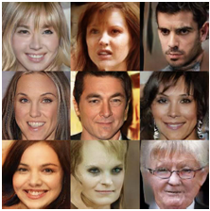
Proposed Model for Image DF Detection
Testing Split
Images
Training Split
Preprocessing
Labels
Unify Image Format (JPEG)
Unify Images Size
Feature Extraction
Image Forensics (Error Level Analysis)
Wavelet Packet Transform
CNN
Balanced Mix of Real and Fake Images
+
Classification
SVM/KNN
Real/Fake

Slide 6
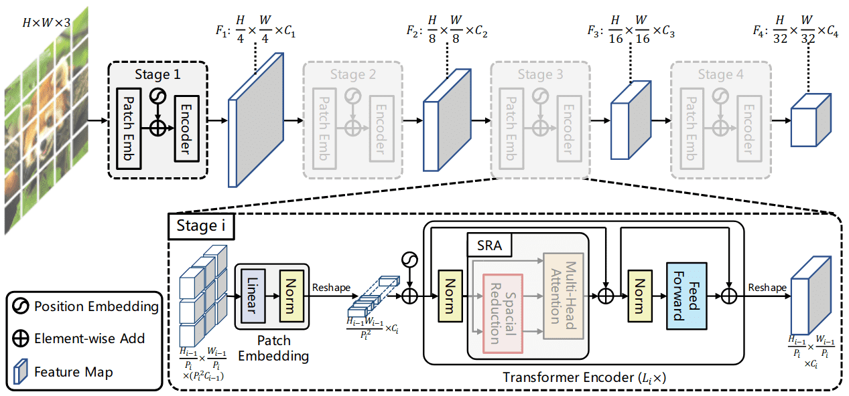
VIT

Slide 7
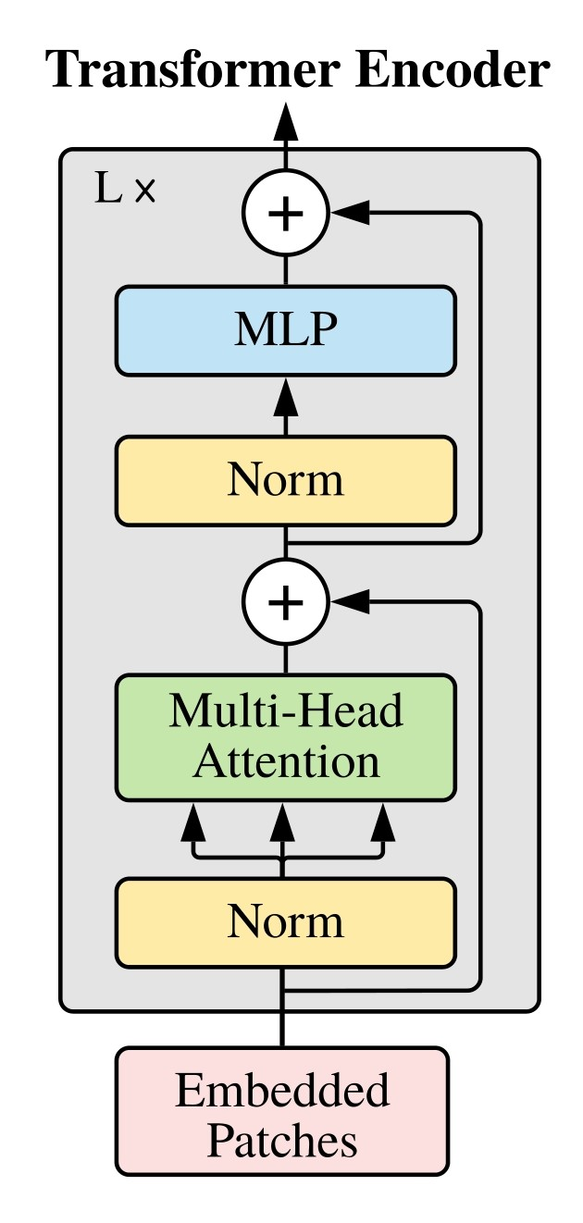
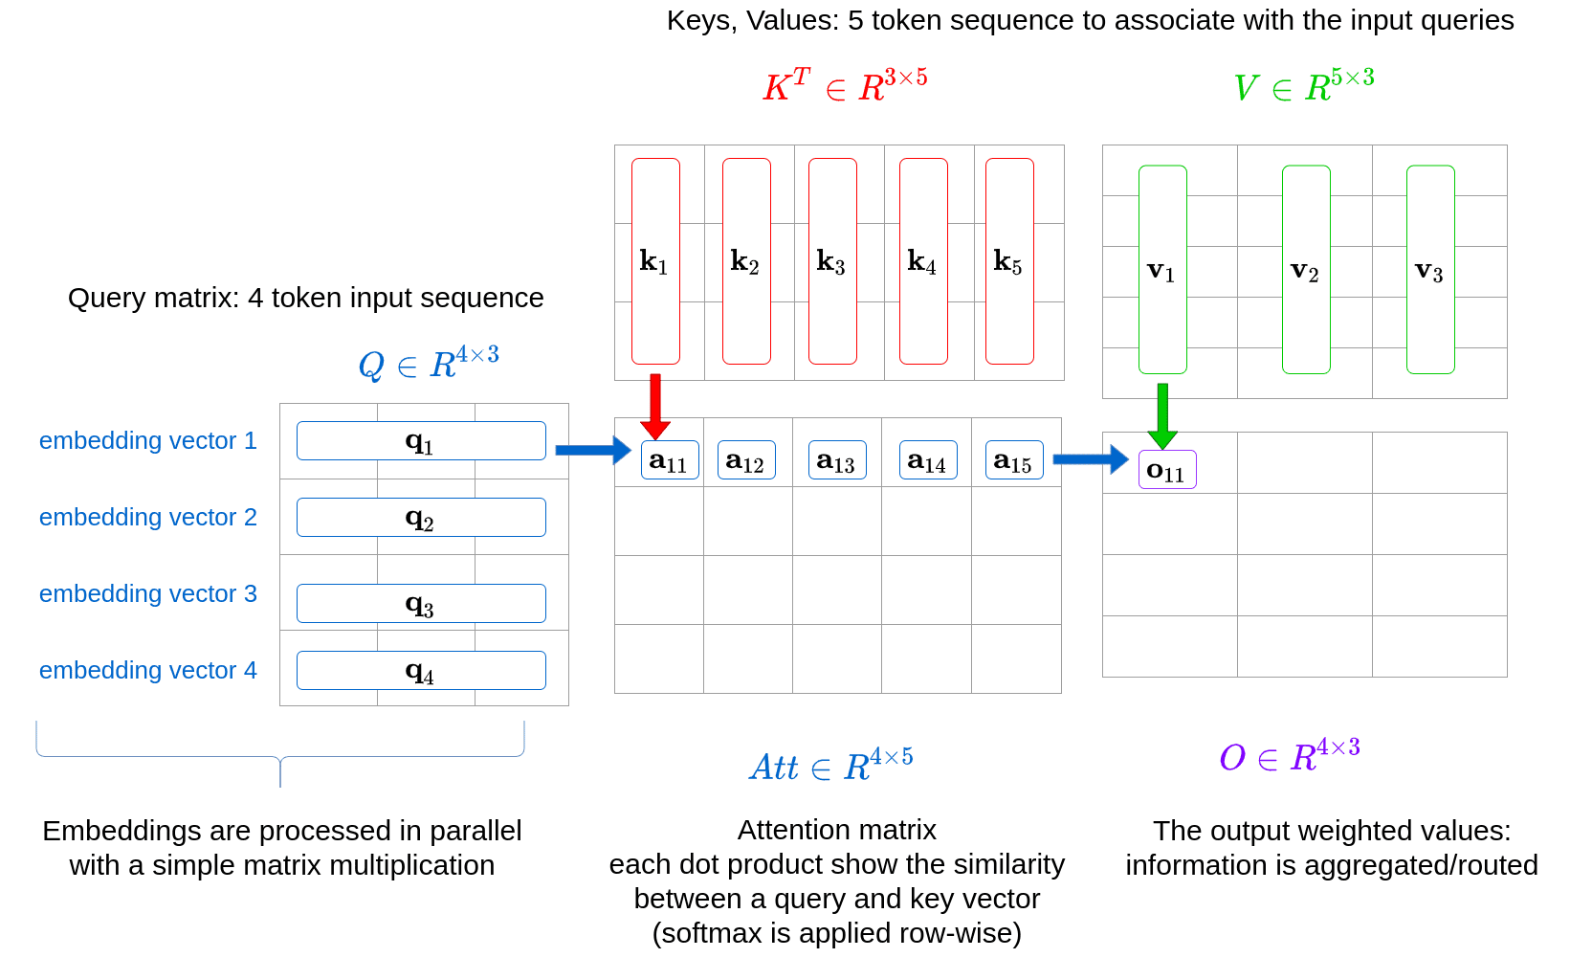
Proposed Model for Attention

Slide 8
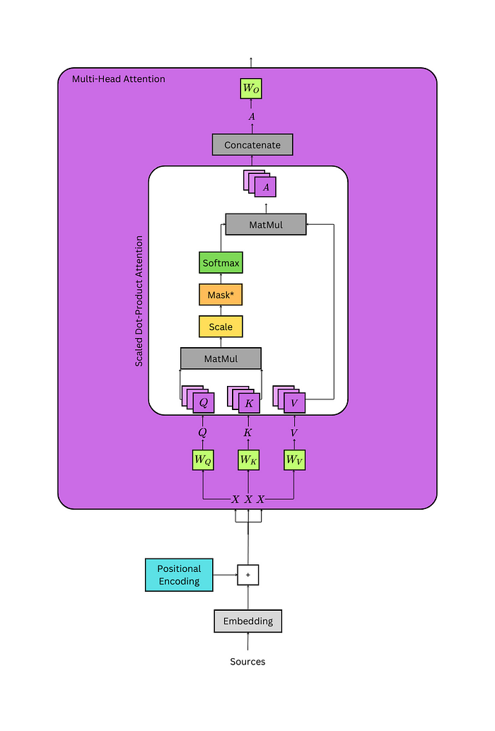
Proposed Model for Attention

Slide 9
Proposed Dataset
In my research I will use any (or all) of the following datasets to train and evaluate my model especially because they have ben used in previous approaches , hence it will help to compare my results with previous ones.
No. | Datasets for Deep Fake | Note
1 | Flickr-Faces-HQ (FFHQ)
2 | Large-scale CelebFaces Attributes (CelebA) | 10,177 number of identities, 202,599 number of face images, and 5 landmark locations, 40 binary attributes annotations per image.
3 | LSUN (Large-scale Scene UNderstanding Challenge) | The LSUN classification dataset contains 10 scene categories, such as dining room, bedroom, chicken, outdoor church, and so on. For training data, each category contains a huge number of images, ranging from around 120,000 to 3,000,000. The validation data includes 300 images, and the test data has 1000 images for each category.

Slide 10
Proposed Tools
Hardware:
Initially I will rely on my personal laptop with the following configuration:
Processor: 12th Gen Intel(R) Core(TM) i7-12700H 2.30 GHz
RAM: 32.0 GB
GPU: Nvidia: GeForce RTX3070 Ti Laptop GPU , 8 GB GDDR6
OS: Windows 11 Home
If the performance of my laptop is not enough (probably needs higher GPU), I will refer to the university for support with a cloud VM of higher configurations.
Software:
VsCode and Python 3.11
Pytorch for building DNN and CNN
Scikit-learn for SVM and KNN
OpenCV for image Manipulation.
PyWavelets for dealing with wavelet transform.
Matplotlib for visualization

Slide 11
Proposed Project Plan (Gant Chart)
 |  |  |  | December |  |  |  |  |  |  |  |  |  |  |  |  |  |  |  |  | January |  |  |  |  |  |  |  |  |  |  |  |  |  |  |  |  |  |  |  |  |  |  |  |  |  |  |  |  |  |  | February
 |  |  |  | 15 | 16 | 17 | 18 | 19 | 20 | 21 | 22 | 23 | 24 | 25 | 26 | 27 | 28 | 29 | 30 | 31 | 1 | 2 | 3 | 4 | 5 | 6 | 7 | 8 | 9 | 10 | 11 | 12 | 13 | 14 | 15 | 16 | 17 | 18 | 19 | 20 | 21 | 22 | 23 | 24 | 25 | 26 | 27 | 28 | 29 | 30 | 31 | 1 | 2 | 3 | 4 | 5 | 6 | 7 | 8 | 9 | 10 | 11 | 12 | 13 | 14 | 15 | 16 | 17 | 18 | 19 | 20 | 21 | 22 | 23 | 24 | 25
Milestone description | Start | Days |  | F | S | S | M | T | W | T | F | S | S | M | T | W | T | F | S | S | M | T | W | T | F | S | S | M | T | W | T | F | S | S | M | T | W | T | F | S | S | M | T | W | T | F | S | S | M | T | W | T | F | S | S | M | T | W | T | F | S | S | M | T | W | T | F | S | S | M | T | W | T | F | S | S
Phase 1: Theoretical Research
Study theory of Generative AI (Auto encoder, GAN , DDPM) | 12/15/2023 | 3
Studying Image Formats (Lossy : JPEG, Lossless: PNG) | 12/18/2023 | 2
Reading in Deep Fake detection | 12/20/2023 | 3
Study theory of wavelets for computer vision | 12/23/2023 | 2
Researching Suitable Datasets (Like: Flickr-Faces-HQ) | 12/25/2023 | 1
Draft Section 2 and 3 of the Paper | 12/26/2023 | 1
Submit to Review | 12/26/2023 | 1
Revision By the Supervisor | 12/27/2023 | 4
Include recommendations of Supervisor | 12/31/2023 | 1
Complete Phase 1 | 12/31/2023 | 1 |  |  |  |  |  |  |  |  |  |  |  |  |  |  |  |  |  | 1
Phase 2: Tools Preparation
Study OpenCV Library | 12/27/2023 | 2
Reviewing Pytorch | 1/1/2024 | 3
Decide Min HW Configuration for Training the Models | 1/4/2024 | 1
Download the Datasets | 1/4/2024 | 1
Get the setup ready | 1/5/2024 | 3
Complete Phase 2 | 1/7/2024 | 1 |  |  |  |  |  |  |  |  |  |  |  |  |  |  |  |  |  |  |  |  |  |  |  |  | 1
Phase 3: Writing Code
Coding Image Pre Processing | 1/8/2024 | 3
Coding the Features Extraction Model | 1/11/2024 | 4
Coding the Classification Model | 1/15/2024 | 5
Coding Measurement Metrics | 1/20/2024 | 1
Coding Visualization | 1/21/2024 | 2
Model Training and Optimize Hyper Parameters | 1/23/2024 | 7
Draft Sections 4 and 5 of the Paper | 1/30/2024 | 2
Submit to Review | 1/31/2024 | 1
Revision By the Supervisor | 2/1/2024 | 4
Include recommendations of Supervisor | 2/5/2024 | 1
Complete Phase 3 | 2/5/2024 | 1 |  |  |  |  |  |  |  |  |  |  |  |  |  |  |  |  |  |  |  |  |  |  |  |  |  |  |  |  |  |  |  |  |  |  |  |  |  |  |  |  |  |  |  |  |  |  |  |  |  |  |  |  |  | 1
Phase 4: Finalizing the Paper
Complete the remaining sections | 2/1/2024 | 2
Optimize Spelling, Grammer and Formating | 2/6/2024 | 1
Submit to Review | 2/6/2024 | 1
Revision By the Supervisor | 2/7/2024 | 4
Include recommendations of Supervisor | 2/11/2024 | 1
Submit Paper and Complete Phase 4 and the Project | 2/11/2024 | 1 |  |  |  |  |  |  |  |  |  |  |  |  |  |  |  |  |  |  |  |  |  |  |  |  |  |  |  |  |  |  |  |  |  |  |  |  |  |  |  |  |  |  |  |  |  |  |  |  |  |  |  |  |  |  |  |  |  |  |  | 1
Deadline of the Project Submission | 2/25/2024 | 1

Slide 12
Thank You!

